Slide 1


Teddy Lazebnik, Chana Weitman, Gal A. Kaminka
Maverick Group, Computer Science Department

Slide 2
My PhD goal: auto generate nanodevice swarms
Combinations of different nanodevices
[swarm]
Goal
Library of known nanodevices and their properties
Software
[Bilbo]
Programming language code [Athelas]
First work from our group by Inbal Wiesel
Slide 2
Notes:
לעבור על זה מהר – 2 דקות מקסימום, להתחיל מה עשו בקבוצה ומה שלי ואז מה המטרה הסופית

Slide 3
The process of creating library of medical nanodevices
Filter relevant papers
Let domain experts mark properties in papers
Convert PDFs to machine-readable text format
Extract pairs of property and value from papers
Join the results into a table and inform about ambiguity
Slide 3
Notes:
להסביר את המעבר הלא ליניארי, לדלג על החלקים ההנדסיים יותר ואז להגיד בואו נתרכז במשימה הראשונה

Slide 4
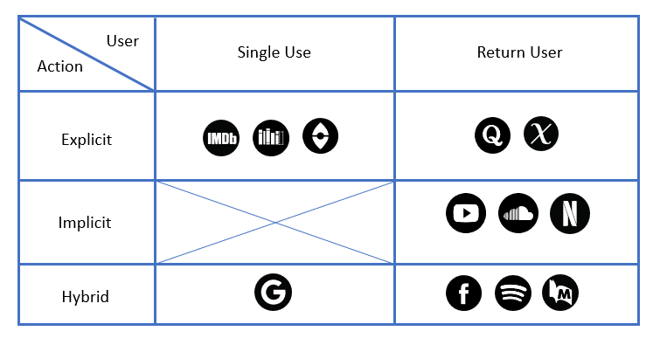
One time and life time users
One time
Life time
Life time
Quora subject notification
whatshouldireadnext.com
Explicit
Youtube’s recommended panel
Implicit
Implicit
Google’s search
Facebook’s feed
Both
Slide 4
Notes:
בדקה וחצי להסביר כל מקרה מ 5 הדוגמאות כדי לחדד את ההבדל בין המקרים
זה השקף שאני יכול להוריד אם אין לי זמן – שקף לפני להגיד שאנחנו מחפשים משהו באמצע

Slide 5






Google and Spotify: different life time learning approach
Google – linear profile matching
Spotify – cross listing
20%
40%
Song E
Song A
10%
Song B
Song A
Song C
Song B
30%
Song D
Song C
Song E
Song D
Slide 5
Notes:
בחצי דקה לכל אחד – איך האלגוריתם פרסונליזציה של גוגל ושל ספוטיפי עובדים

Slide 6
Project based search: hypothesis
Problem: users tend to change context while reviewing some subject.
Hypothesis: if users explicitly declare their context, it helps to understand their behavior
Execution: before searching, ask the user to declare which subject s/he interested in
Slide 6

Slide 7
Project based search: academic search engine
The user writes a query and declares on which project s/he works on
How similar is the new query comparing to previous queries in the same project
Score similarity of each new result compared to previous relevant results in the same project
Remove results with a score below the mean of the new results
Present the results to the user from the highest score to the lowest one
Slide 7

Slide 8

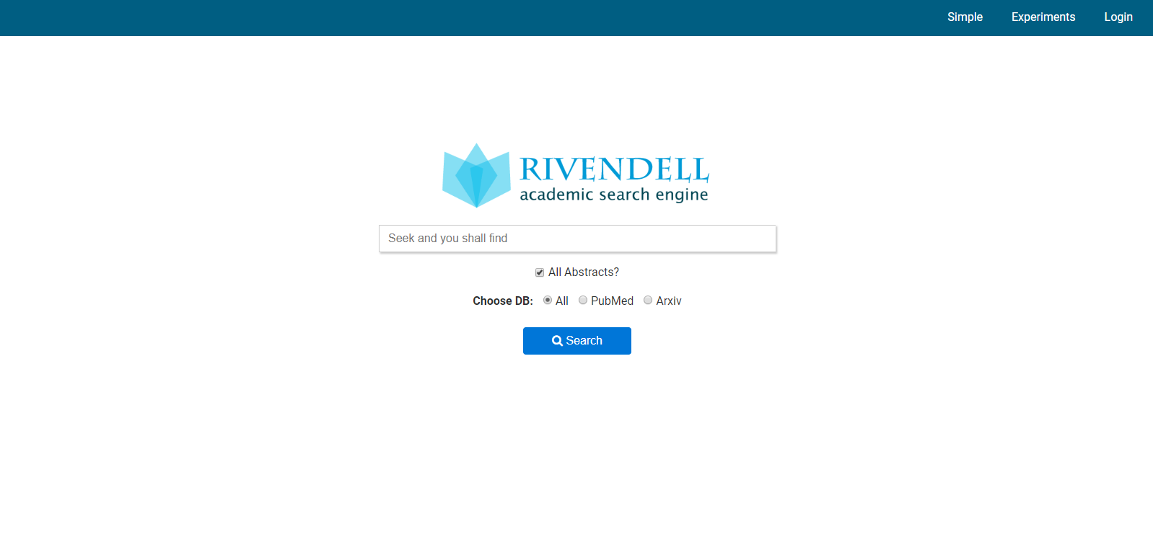
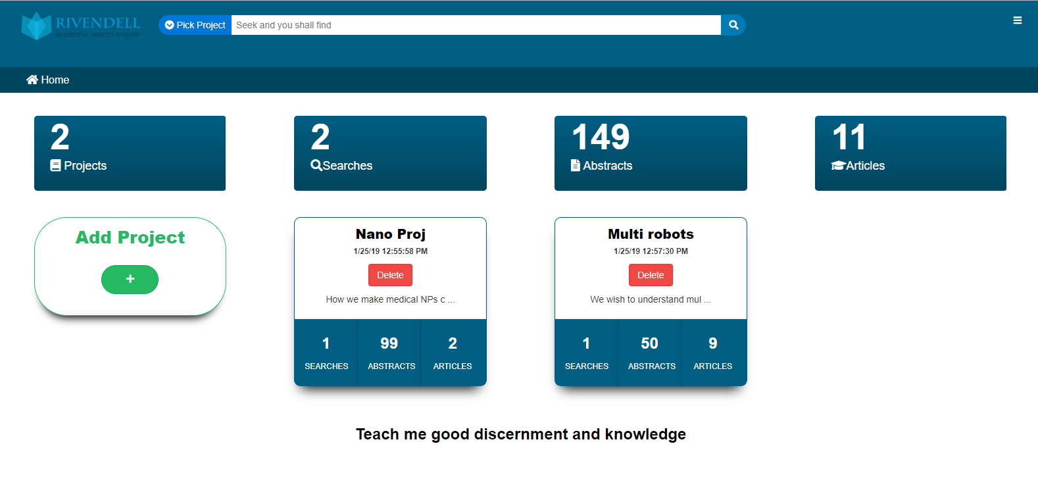

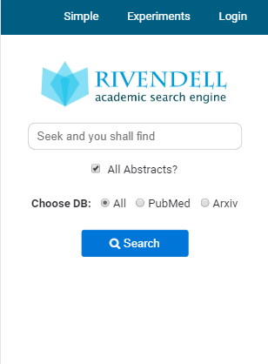

Rivendell – academic search engine
Slide 8
Notes:
רק להראות שיש ריוונדל ואפשר להשתמש בו
להראות את הצורה שבא אני מחפש – חיפוש למלה ואז להראות תוצאות עם כפתורים של רוונלטי או לא

Slide 9
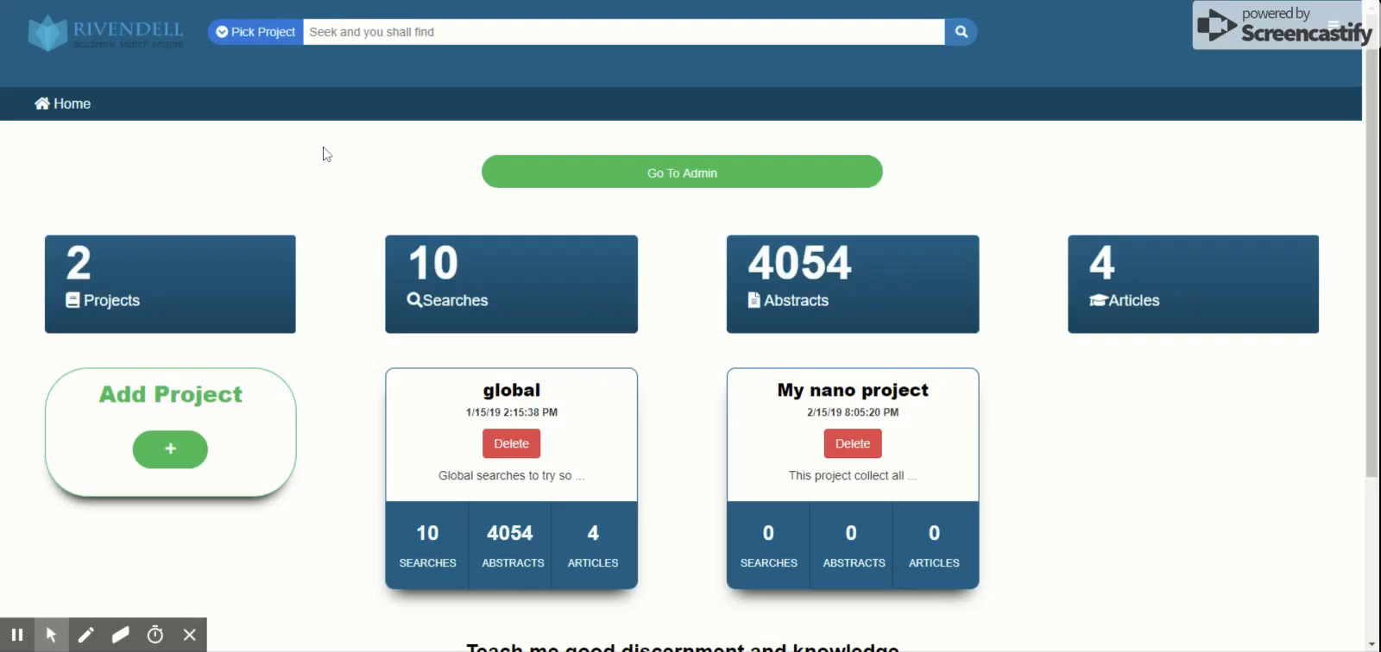
Rivendell – academic search engine
Slide 9
Notes:
רק להראות שיש ריוונדל ואפשר להשתמש בו
להראות את הצורה שבא אני מחפש – חיפוש למלה ואז להראות תוצאות עם כפתורים של רוונלטי או לא

Slide 10
Project based search experiment #1
Random
Baseline
Project based
Life time
A user asked to pick a subject in mind
Search something related to the subject in Rivendell
X 2
X 3
Mark the first 10 results as relevant or irrelevant
We expect “Baseline”, “Random” to perform worse than “Project based” and “Life time”
We expect “Project based” to preform similar to “Life time” on the first 3 searches
We expect “Project based” to preform better then “Life time” on the last 3 searches
Slide 10
Notes:
לכל אחד מהקבוצות להסביר מה היא ולמה בחרנו לבדוק אותה

Slide 11
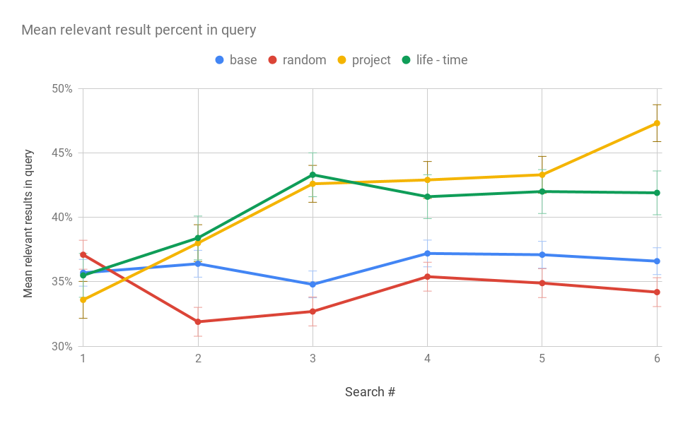
Project based search experiment #1: results
Up is better
Slide 11
* Each point represent 25 users,
250 marks of abstracts
Notes:
לדבר על התוצאות ב – 2 שלבים, עד חיפוש 3 ואז עד חיפוש 6

Slide 12
Next search recommendation: hypothesis
Problem: users may need a lot of time to learn how to optimize the results of a search engine
Hypothesis: if users explicitly declare which results were relevant, suggest the next search
Execution:
1. Allow the user to mark each result as relevant or not
2. Present keywords that by adding them to the query, the results should improved
3. Allow the user to pick one of them or search for something else
Slide 12
Notes:
לתקן גרמר של

Slide 13
Project based search experiment #2
Only search
The user does not see recommendations
Only recommendation
The user must pick only a recommended next query
Recommendation and search
The user may pick a recommended next query or write one
A user asked to pick a subject in mind
Search something related to the subject in Rivendell
X 5
Mark the first 10 results as relevant or irrelevant
Slide 13
Notes:
מה ההבדל בחיפושים

Slide 14
Project based search experiment #2: expectations
We expect “Only recommendation” to perform similar to “Recommendation and search”
We expect “Recommendation and search” to perform better than “Search only”
Only search
The user does not see recommendations
Only recommendation
The user may pick only a recommended next query
Recommendation and search
The user may pick a recommended next query or write one
Slide 14
Notes:
מה ההבדל בחיפושים

Slide 15
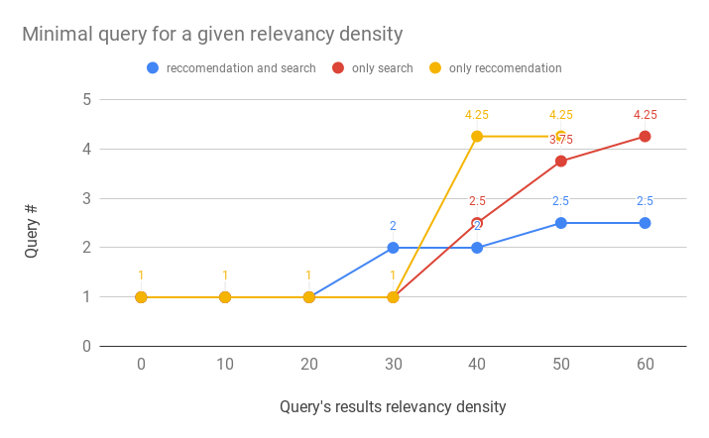
Project based search experiment #2: results
Down is better
Slide 15
* The data is from 30 users, 1500 marks in total.
Notes:
להסביר בקצרה

Slide 16
The process of creating library of medical nanodevices
Filter relevant papers
Let domain experts mark properties in papers
Convert PDFs to machine-readable text format
Extract pairs of property and value from papers
Join the results into a table and inform about ambiguity
Slide 16
Notes:
להסביר את המעבר הלא ליניארי, לדלג על החלקים ההנדסיים יותר ואז להגיד בואו נתרכז במשימה הראשונה

Slide 17
Library of medical nanodevices
Challenge: Creating a library of nanodevices for medical usage in a machine-readable form
Proposed solution: All the data is available in academic papers, extract it from the papers
The papers are in PDF file format
The papers are in English
The papers are written for humans
Technical Challenge: human written text is hard for computers to extract insights from
Slide 17

Slide 18



Library of medical nanodevices – technical challenge
Property: Size
TEM image revealed quasi-spherical shapes of an average diameter of $9.10±1.12$ nm for Ag NPs.
[Akinsiku, Dare, Ajanaku 2018]
The results show that the size of Cur-AnNPs@GFMS is about 1 $μm$ with a thickness of 5-25 nm.
[Malekmohammadi, Hadadzadeh, Farrokhpour, Amirghofran 2018]
The nanoparticles injected to a tumor with diameters of 8 $μm, 20 nm respectively.$
Slide 18
Notes:
להחליף ציטוטים בכותבים עם שנה

Slide 19
Goal: auto generate nanodevice swarms
Library of medical nanodevices is the first step
Project based search improves results in academic search
www.rivendellscholar.info
Teddy Lazebnik - lazebnik.teddy@gmail.com
Chana Weitman - weitman@mail.biu.ac.il
Gal Kaminka - galk@cs.biu.ac.il

